Slide 1



Datacore Consultants
Decoding Success with AI : Our Algorithms, Your Growth!

Slide 2


About Us
We are a result-driven consulting organization committed to continuous learning and improvement, staying abreast of industry trends, emerging technologies, and best practices.
Our success lies in helping our clients achieve their goals while upholding the highest ethical standards.
Our team of seasoned domain experts at Datacore Consultants brings a wealth of experience in data engineering, machine learning, and advanced analytics.

Slide 3
Case Study
Challenges faced by contact centres in maintaining customer satisfaction and loyalty
High Operational Costs: Maintaining a large team of human agents is expensive, with costs including salaries, training, and infrastructure.
Agent Burnout: Repetitive and monotonous tasks lead to high employee burnout, impacting productivity and service quality. It also leads to high agent attrition.
Scalability Issues: During peak times, it is challenging to scale human resources quickly to meet the increased call volumes.
Inconsistent Service Quality: Variability in agent performance can lead to inconsistent customer experiences.
Negative ROI Processes: Certain processes, such as handling frequent simple queries, often result in negative ROI due to their high handling costs and low revenue impact.

Slide 4
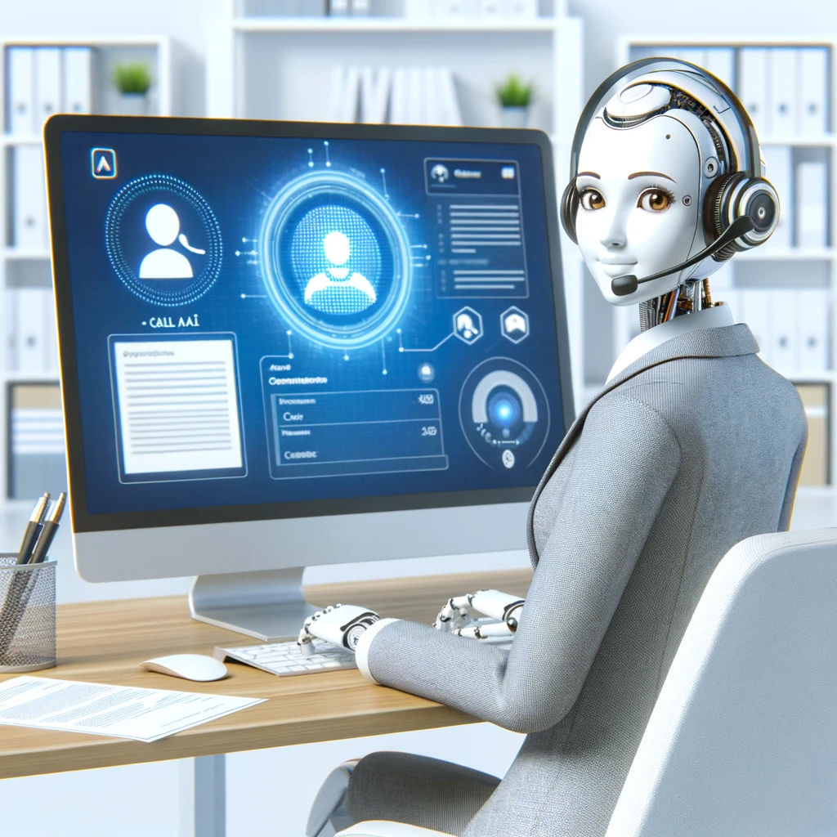
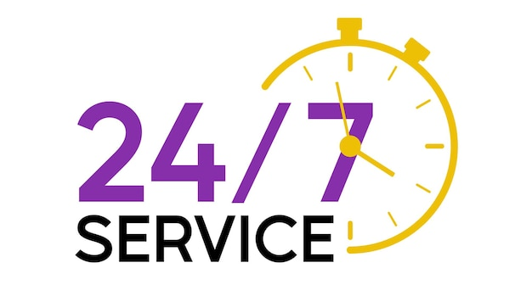


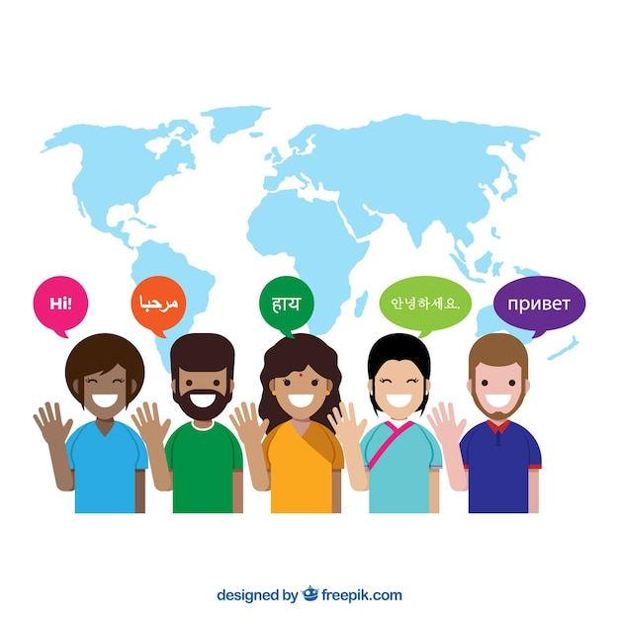
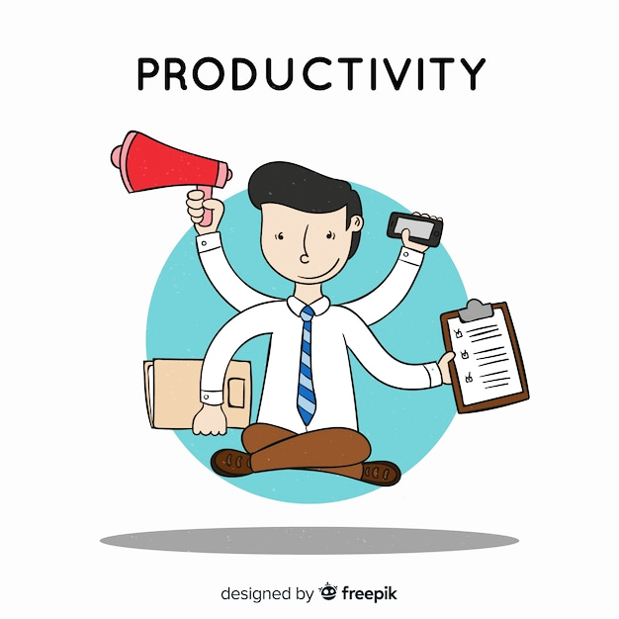

Meet Vaani - Our Speech Assistant
24/7 Availability
Unlike human agents, Vaani operates round-the-clock, providing uninterrupted customer support.
Scalable Solution
Whether it’s a sudden spike in calls or a need for long-term scalability, Vaani adjusts effortlessly to demand changes.
Real-Time Data Retrieval and Responses
Vaani can quickly access and retrieve information from business documents, ensuring accurate and quick responses.
Custom Voice Integration with Language and Accent Adaptation
Vaani is trained on human voices to understand and respond in multiple languages and accents, catering to a diverse customer base.
Automating Routine Queries
Vaani efficiently handles routine queries, freeing up human agents for more complex tasks.
Data Security and Privacy
Data processing with utmost data security standards and compliances including HIPAA, GDPR, etc.

Slide 5
Ideation of Vaani
How do we define a “human-like’ conversation?
All human conversations can be broken down into 3 steps:
Listen to what the other person is saying
Understand the context of what the other person has asked and think of an appropriate response to be spoken
Speak the response to the other person
All the above processes have been integrated into Vaani’s core, including additional features like :
Multiple voices : Vaani already has a wide range of 60+ voices including different accents.
Voice Cloning and Modulation : It is also possible to clone, modulate and train Vaani on custom or user voices.
Emotions : Vaani has been trained to respond based on different emotions to tackle different scenarios and industry specific challenges.

Slide 6


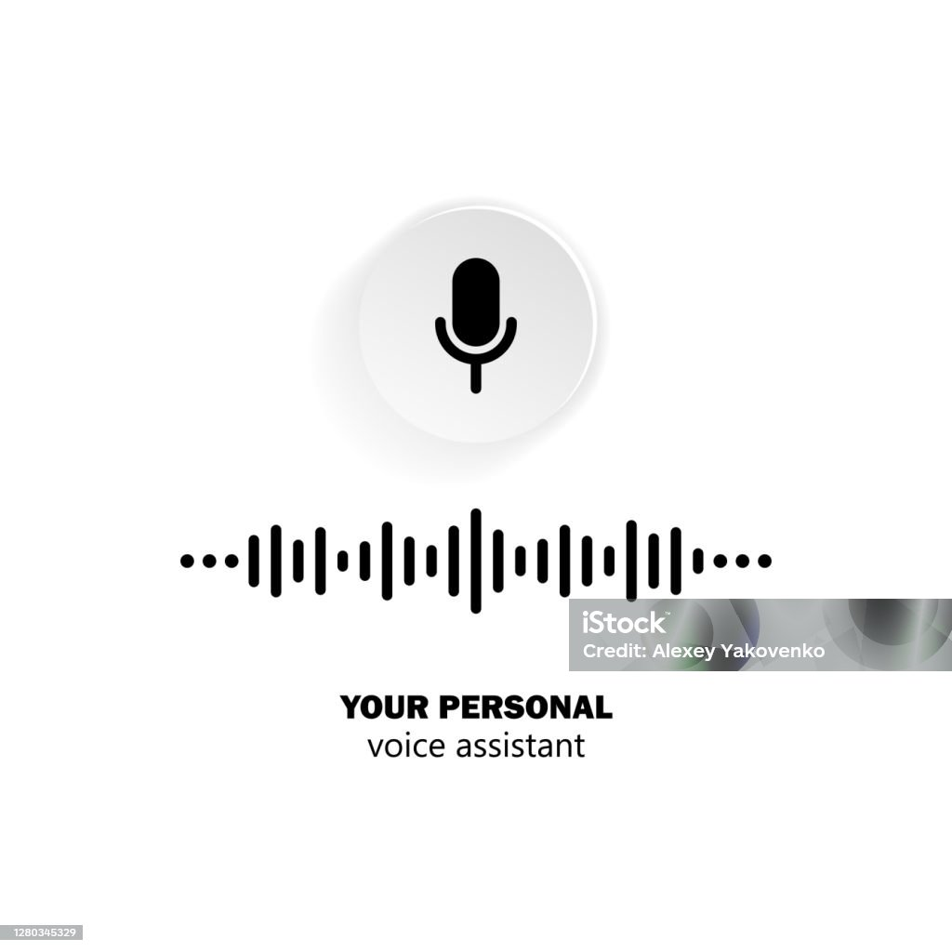

How does it work?
Vaani is an advanced AI-powered contact center representative designed to enhance customer service operations by automating call handling and providing real-time, human-like interactions. Unlike traditional automated systems, Vaani leverages state-of-the-art LLMs and Machine Learning algorithms to understand and respond to customer queries with high accuracy and empathy.
Vaani - Workflow
1
Speech To Text
Business Knowledge, SOP, Guidelines, etc.
2
Information Retrieval
Text To Speech
3

Slide 7
Why pick Vaani over manual operations?
High attrition mandates recruitment and training process to compensate the manpower
Challenging to scale human resources quickly to meet the increased call volumes during peak times
Cut down on training time—Vaani’s here to keep your team running smoothly!
"Vaani adapts to call spikes, so your service never skips a beat."
REASONS FOR AGENT UNAVAILABILITY
Repetitive and monotonous tasks lead to
high employee burnout
Agent unavailability during holidays as well as after office hours
Wave goodbye to burnout—Vaani handles the boring stuff so your team can excel!
After hours or Holidays? No problem. Vaani’s here to ensure continuous support!
Infrastructure blackout halts even the emergency and urgent customer services
Vaani keeps the lights on—no blackout can stop your emergency services!

Slide 8
Case Study
Challenges faced by contact centres in maintaining Customer Satisfaction and Loyalty
Opportunities with Vaani to improve Customer Satisfaction and Loyalty
High Operational Costs: Maintaining a large team of human agents is expensive, with costs including salaries, training, and infrastructure.
Cost Reduction: By automating repetitive and low-value tasks, Vaani significantly reduces operational costs.
Agent Burnout: Repetitive and monotonous tasks lead to high employee burnout, impacting productivity and service quality. It also leads to high agent attrition.
Improved Agent Satisfaction: Offloading monotonous tasks to Vaani allows human agents to focus on more complex and rewarding interactions, reducing burnout and increases employee retention.
Scalability Issues: During peak times, it is challenging to scale human resources quickly to meet the increased call volumes.
Enhanced Scalability: Vaani can handle unlimited call volumes, ensuring seamless service during peak times.
Inconsistent Service Quality: Variability in agent performance can lead to inconsistent customer experiences.
Consistent Service Quality: Vaani provides consistent and accurate responses, enhancing overall customer satisfaction.
Negative ROI Processes: Certain processes, such as handling frequent simple queries, often result in negative ROI due to their high handling costs and low revenue impact.
Positive ROI: Automating processes with low ROI improves overall business profitability.

Slide 9




Contact Us
Pritesh Jha
Rahul Mishra
+91-983 311 5874
+91-897 667 0473
pritesh.jha@datacoreconsultants.com
rahul.mishra@datacoreconsultants.com
For further assistance, please reach out to our marketing team at the following:
marketing@datacoreconsultants.com
+91-897 658 1583
www.datacoreconsultants.com

Slide 10


